Slide 1
NEUROSCIENCE in Infancy and Adolescensce Conference
Transformative Individualized Transcranial Magnetic Stimulation
With Specific Application to Autism

Slide 2
Individualized Transcranial Magnetic Stimulation
Notes from the Leading Edge
Robert D. Silvetz, M.D.
Former Director, Isynchrony Clinic
Former Science Officer, Newport Beach Brain Research Labs (NBRL)

Slide 3
DISCLOSURES
Conference sponsors have covered travel and lodging expenses
I receive no honorarium for this presentation(s)
I have no financial relationship with BTC/NBRL/WaveNeuro
I have no conflicts of interest relative to the subject matter covered

Slide 4
Credits
Many thanks for conversations on the neuromodulation topic over 6 years to
Robert Cancro, M.D., Chairmain Emeritus, Pyschiatry, NYU
E. Roy John, NYU, [unfortunately passed on but his papers speak for him]
Leslie Prichep, Ph.D.
Yi Jin,M.D., for first insight in alpha therapies
Bob Eisenhart,Ph.D., for encouraging alpha therapies
Kevin Murphy, M.D., UCSD, Vice-Chair Radiation Oncology
Charles Knezevich, former Assoc. Prof. UCSD
Charles Liu, NeuroSurgery Chief, Keck School of Medicine
All of whom may have wild disagreement with vast swaths of this presentation.

Slide 5
NeuroModulation
That’s the technical term
It’s purely hypothetical that is happening
We have good reasons to believe it’s happening
Shannon’s First Law
Dramatic EEG changes
Epilepsy and neurosurgeons
We are not here concerned with cause
We are trying to route around or repair the damage

Slide 6
No Matter What It is Called
There are many protocols out there, many claim uniqueness that yet has to be proven clinically, MeRT, PRTMS, Synchronized TMS
For the sake of this presentation, we call them all
INDIVIDUALIZED TRANSCRANIAL MAGNETIC STIMULATION
iTMS
In their defense, many of these protocols do work and are probably more or less equivalent, with similar outcomes

Slide 7
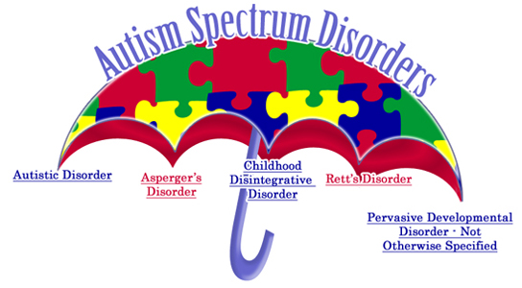
AUTISM
2-in-3 will respond to iTMS
1-in-3 will return to normal
1-in-3 will get a significant improvement in symptoms
1-in-3 will fail therapy
Therapy failures stop treatment at 1 week
Responders continue for 1 to 2 months (4 to 8 weeks total)

Slide 8
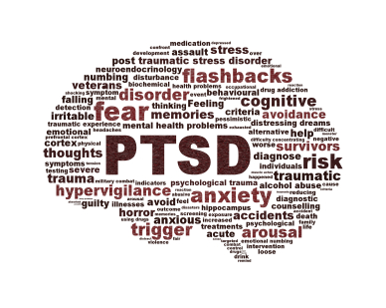
Post-Traumatic Stress Disorder (PTSD)
Up to 3 million have PTSD in some form
800,000 Veterans
150,000 Women Victims of Sexual Trauma
For those whom medication has failed
We can help 95% of the time
In as little as 4-8 weeks
Almost total resolution of symptoms
1-in-20 will relapse
After a year
Come BACK to Us!

Slide 9
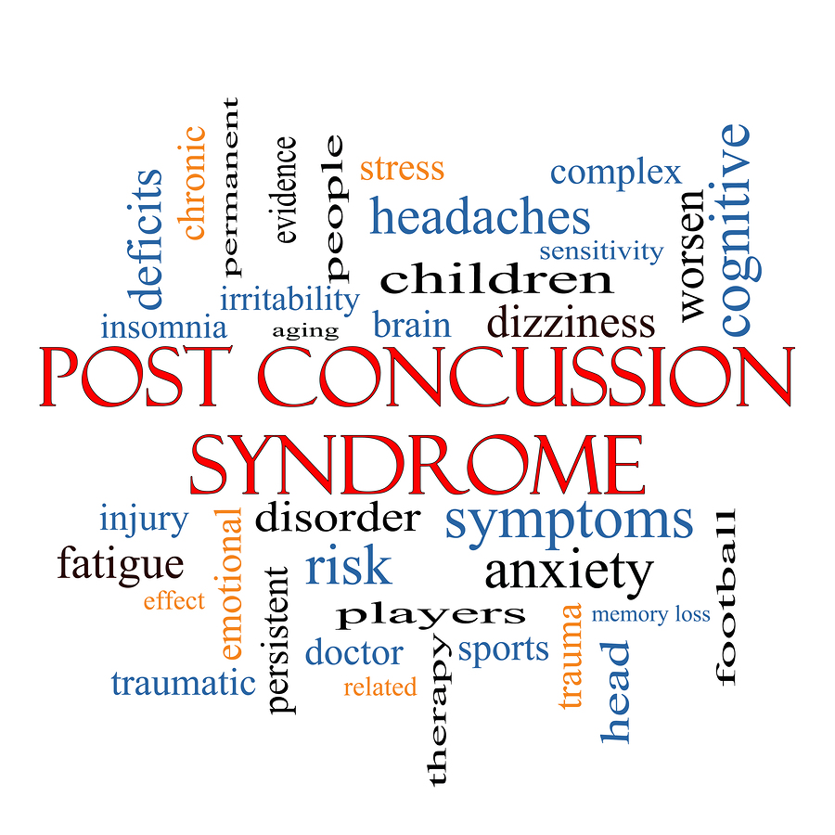
Concussion
Post-concussion symptoms include:
Headaches.
Dizziness.
Fatigue.
Irritability.
Anxiety.
Insomnia.
Loss of concentration and memory.
Noise and light sensitivity.

Slide 10
Concussion
We CAN reverse unremitting symptoms
3-4 weeks of iTMS
Slow, gradual reversal
NO DRUGS (except where needed)

Slide 11
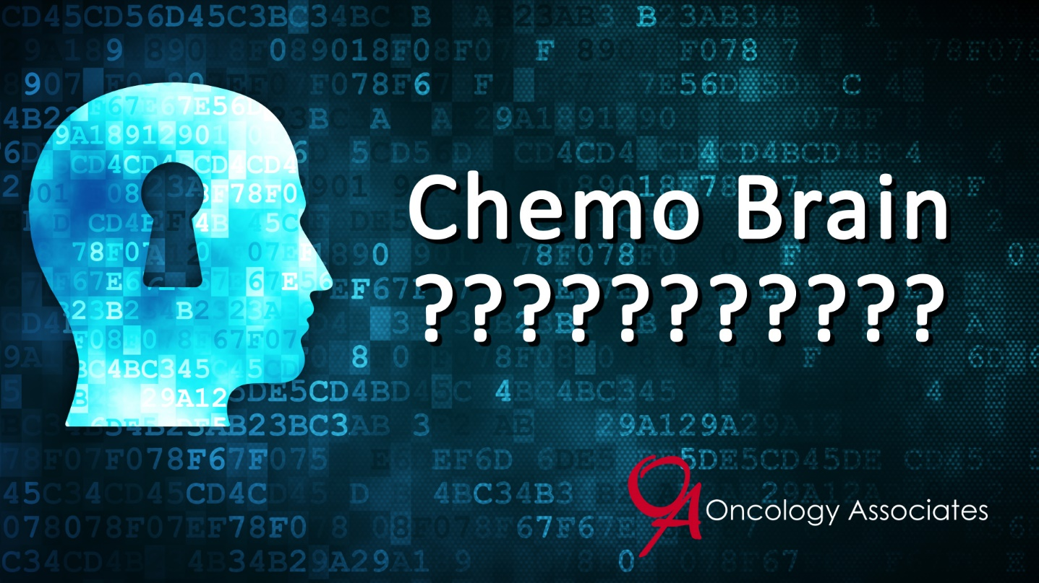
CHEMOBRAIN
Also known as brain-fog from cancer chemotherapy
Being unusually disorganized.
Confusion.
Difficulty concentrating.
Difficulty finding the right word.
Difficulty learning new skills.
Difficulty multitasking.
Fatigue.
Feeling of mental fogginess

Slide 12
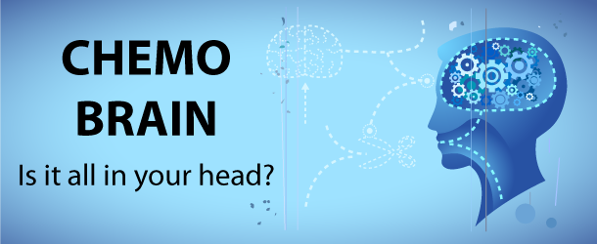
CHEMOBRAIN
8-in-10 can find relief with iTMS
As fast as with 2 weeks of treatment!

Slide 13
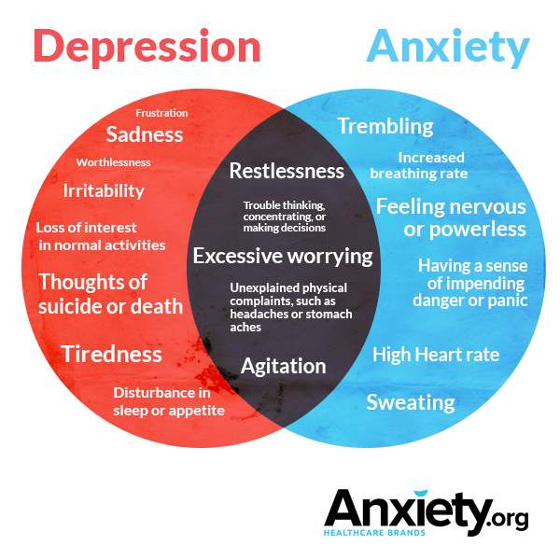
Depression and Anxiety
iTMS does NOT use drugs
We can reduce your medications!
Sometimes stop any drug use
We CAN break the cycle
Crucial lifestyle changes
8-in-10 benefit greatly

Slide 14
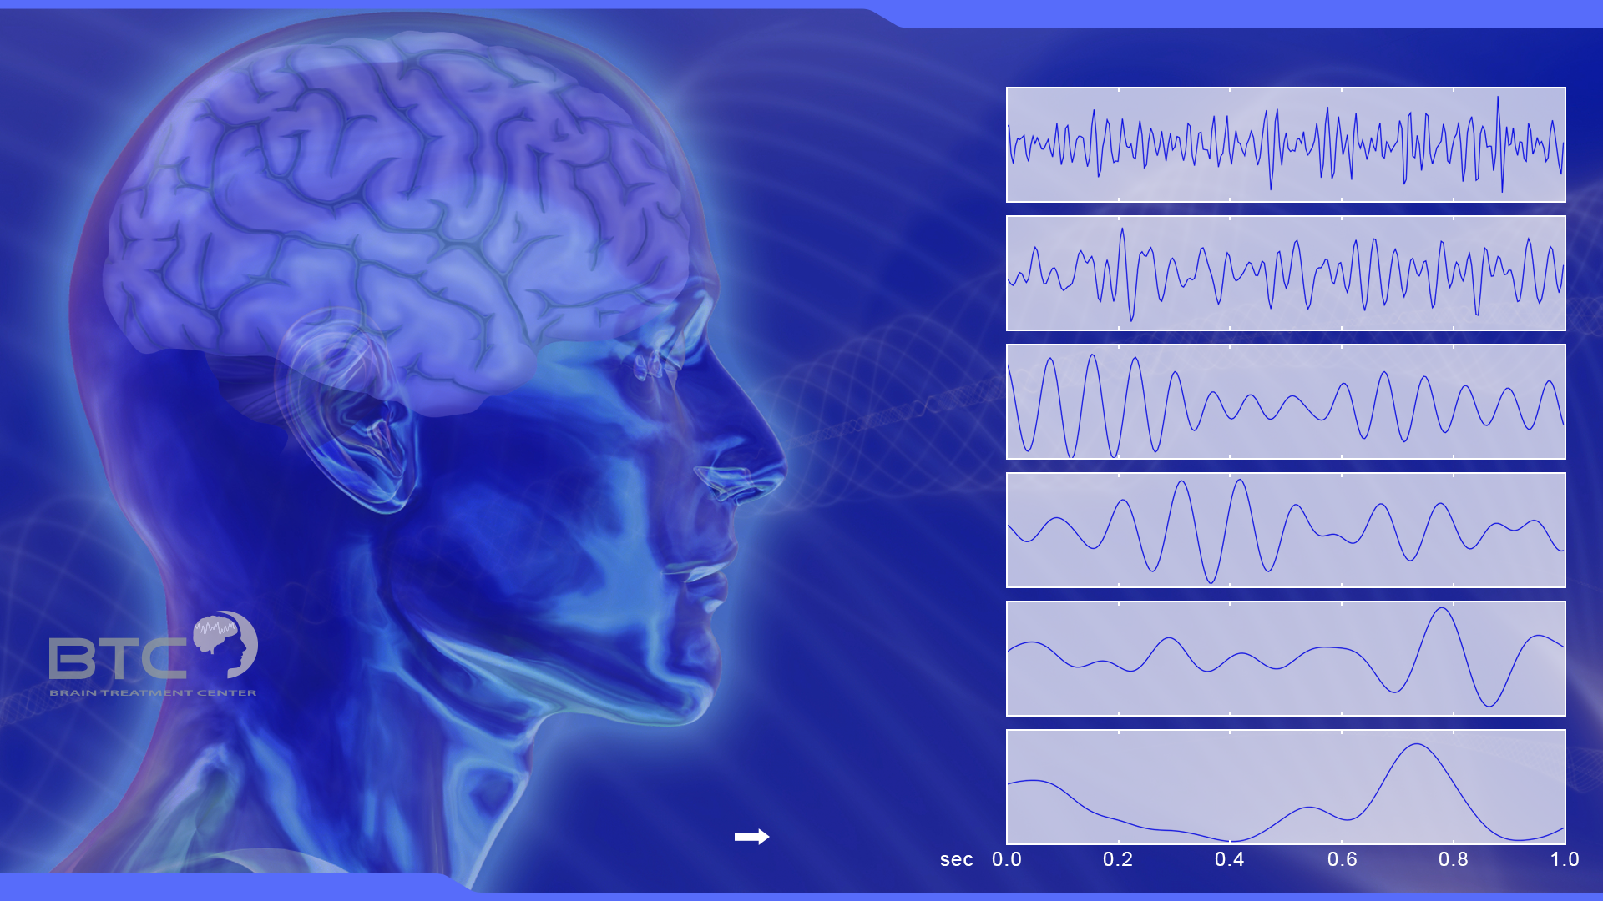
Electroencephalography (EEG)
EEG rhythmic activity frequency bands
gamma waves
(30 Hz to 100 Hz)
Reflects symmetry formation (rhythmic waves)
and symmetry break (desynchronized waves)
in the brain
beta waves
(13 Hz to 30 Hz)
mu waves
(8 Hz to 13 Hz)
and partly overlaps
with other frequencies
alpha waves
(8 Hz to 13 Hz)
theta waves
(4 Hz to 8 Hz)
The electroencephalogram (EEG) is a recording of the electrical
activity of the brain from the scalp. The recorded waveforms reflect
the cortical electrical activity.
Signal intensity: EEG activity is quite small, measured in microvolts (μV).
Signal frequency: the main frequencies of the human EEG waves are:
delta waves
(up to 4 Hz)

Slide 15
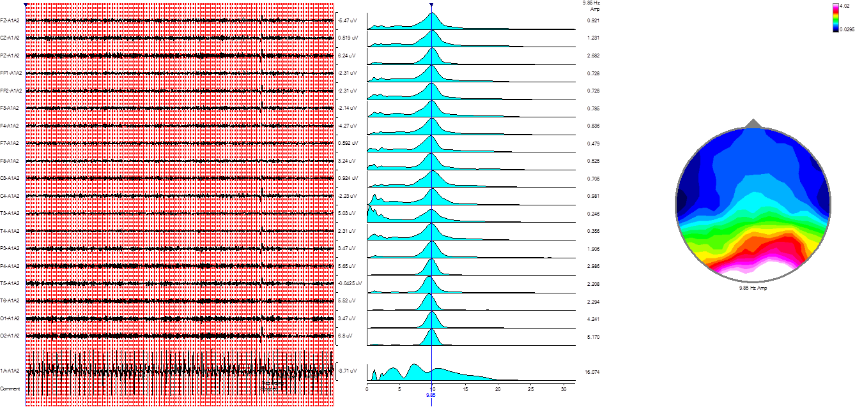
Perfect EEG – Eyes Closed

Slide 16
EEG – The Tool that Guides

Slide 17
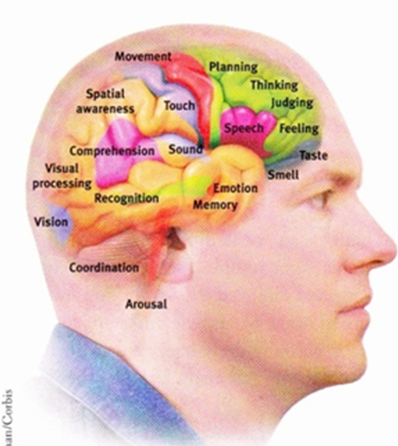
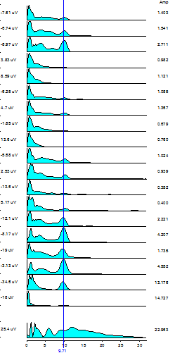

Slide 18

Ideal EEG pattern Autism

Slide 19
Taking an EEG is quick, painless, and noninvasive.

Slide 20
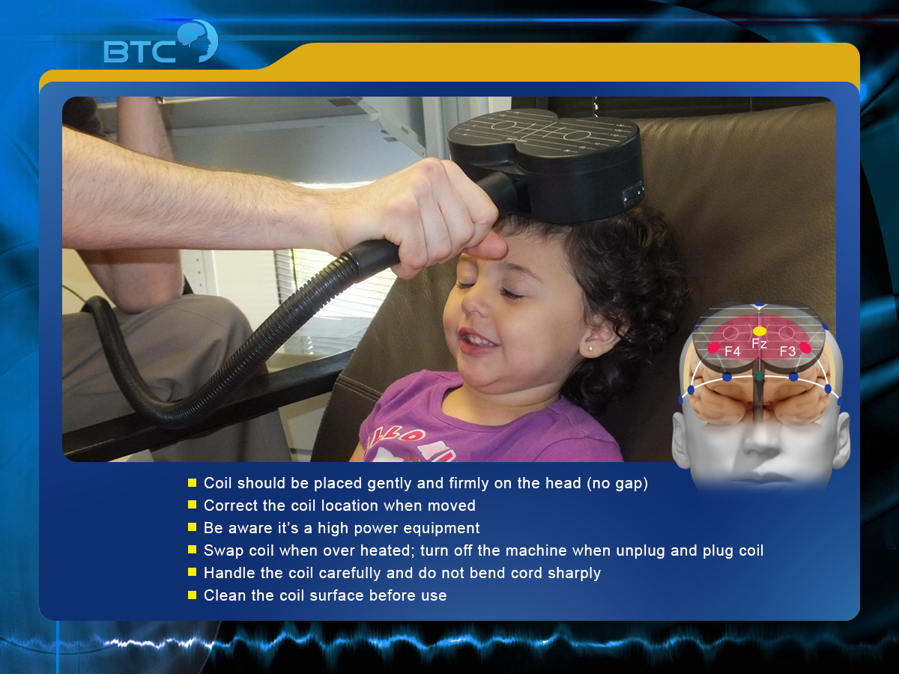
MeRT™ Technical detail

Slide 21
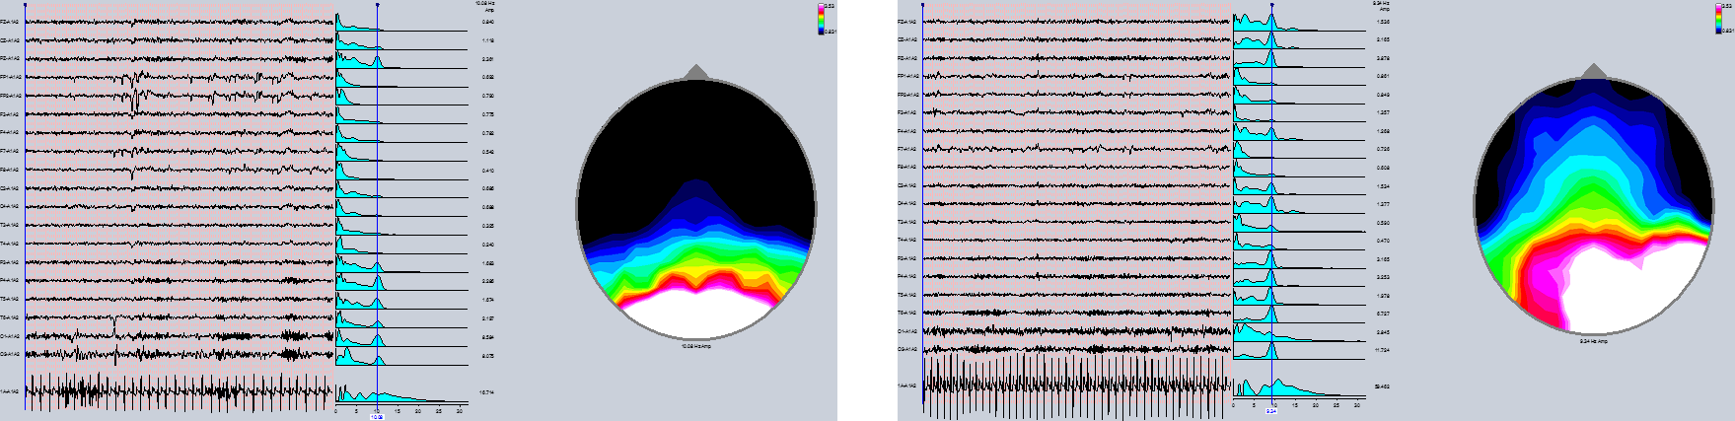
Move From Autism to ‘Neuro-Typical’

Slide 22

Seeing is Believing

Slide 23
Seeing is Believing II

Slide 24
Does it work?
Yes it does
Double-blind results from 2014 and presented at Autism One in May 2014 by NBRL, where the study design by yours truly was acknowledged in keynote session.
Which basically saw in a group of 24 patients
12 to neuro-typical
5 with substantial gains
No change in remaining patients
With continued improvement at 1 year follow-up

Slide 25
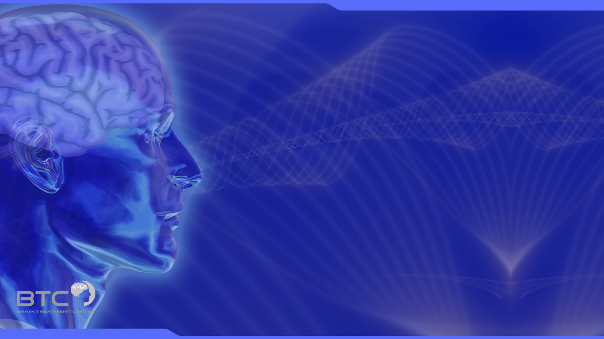
RCT: MRT in Autism Spectrum Disorder - Methods
Inclusion Criteria:
All subjects are 4-12 years of age
Al subjects meet the DSM-IV diagnostic criteria for ASD
CARS total score > 36
Subject’s baseline heart rate and EEG are of sufficient duration and quality that it can be processed for analysis
Exclusion Criteria:
Subject’s legal custodian is unable or unwilling to give informed consent
Subject diagnosed with any other current primary Axis I mood, anxiety, or psychotic disorder
Individual with a clinically defined neurological disorder including, but not limited to :
Any condition likely to be associated with increased intracranial pressure
Space occupying brain lesion
History of seizure
Cerebral aneurysm
Medications that lower the seizure threshold
Previously TMS treated
Significantly unstable medical conditions
Any condition which in the judgment of PI would prevent the subject from completion of the study

Slide 26
Methods (cont.)
Design: RCT
Phase I: 5 week double blind sham controlled treatment
Phase II: 5 week open label active treatment
Evaluation:
Evaluation using CARS at baseline and post MRT weekly
EEG evaluation at baseline and post MRT weekly

Slide 27
Results
28 children with ASD completed Phase I study and 17 of them completed Phase II study.
1 case was excluded from final analysis due to low CARS score at baseline
Age: 7.2±2.3 years old
Gender: 4 girls, 23 boys
Clinical symptoms improved significantly in the double blind trial phase in MRT group while Sham group remained unchanged
Clinical symptoms continued to improve in both groups during the open label MRT treatment
4 cases showed increase in excitement during the first week of treatment and subsided automatically
No SAE in any study subject
Visible EEG improvement (Data will be analyzed separately)

Slide 29
Analysis of CARS Score Change over Time
 |  | Mean | S.D. | N | F | Sig.
Week1 | Sham | 40.3 | 4.5 | 13
 | MRT | 40.3 | 4.0 | 14 | 6.5 | 0.02
Week2 | Sham | 40.2 | 4.4 | 13
 | MRT | 38.0 | 5.0 | 14 | 17.6 | 0.00
Week3 | Sham | 40.2 | 4.2 | 13
 | MRT | 35.6 | 4.7 | 14 | 35.5 | 0.00
Week4 | Sham | 40.0 | 4.1 | 13
 | MRT | 34.1 | 4.4 | 14 | 44.4 | 0.00
Week5 | Sham | 39.4 | 4.1 | 13
 | MRT | 33.4 | 4.9 | 14 | 26.5 | 0.00
Week6 | Sham | 34.0 | 4.9 | 13
 | MRT | 32.9 | 5.6 | 14 | 1.3 | 0.28
Week10 | Sham | 33.1 | 3.7 | 8
 | MRT | 31.6 | 5.9 | 12 | 0.4 | 0.54
Week12 | Sham | 31.6 | 6.1 | 7
 | MRT | 29.7 | 8.0 | 17 | 0.2 | 0.63
Phase I
Phase II
Phase I: ANOVA with Repeated Measure
Overall treatment effect F = 34.2, p = 0.00; Treatment by time: F = 36.4, p = 0.00

Slide 30
Neural Typical* Patients after MRT
Study Phase |  | Double Blind |  |  |  |  | Open Label
Time | Bsln | Wk 1 | Wk 2 | Wk 3 | Wk 4 | Wk 5 | Wk 6 | Wk 10 | Wk 12
MRT | 0/14 | 0/14 | 0/14 | 2/14 | 2/14 | 6/14 | 6/14 | 8/12 | 6/10
Sham | 0/14 | 0/14 | 0/14 | 0/14 | 0/14 | 0/14 | 1/13 | 4/8 | 4/7
Neural typical as CARS score drops below 30.

Slide 32
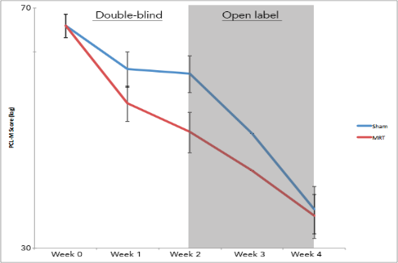
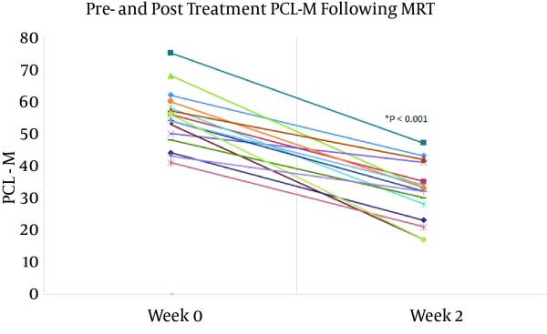
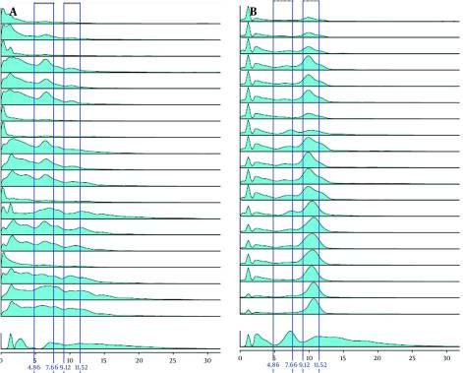
PTSD Cumulative Data
4 Week Double Blind
20 patients
41% PCL-M Drop
Jin,Silvetz et al
Isynchrony Ambulatory Clinic
75 Patients, 5 weeks+
61% PCL-M Drop
Silvetz & co
4 Week Double Blind
80 patients
64.7% PCL-M Drop
Kim et al
2 Week Open Label
21 patients
42% PCL-M Drop
Tagva, Silvetz et al
https://www.ncbi.nlm.nih.gov/pmc/articles/PMC4727473/
Isynchrony
Silvetz
Suicidal To
Non-Suicidal
PCL-M 76
to 17
Before
After
Tagva, Silvetz et al
https://www.ncbi.nlm.nih.gov/pmc/articles/PMC4727473/

Slide 33
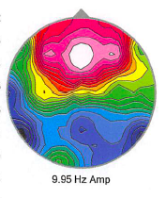
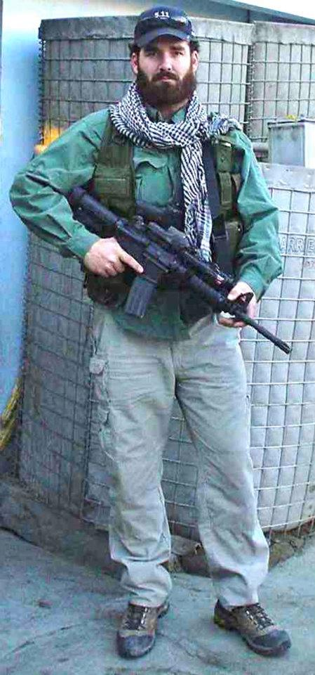
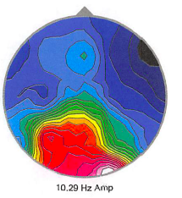
PTSD: 3 Weeks of ITMS Treatment
44 year old Marine: 8 combat deployments
Pre-EEG
Pre-Treatment:
Fight-Flight Syndrome
Hyper-vigilance
Aggressive Temper
Avoidance Issues
3 hrs sleep / night
Post-Treatment:
No more medication required
No more panic attacks
No more anxiety
Normal response to stress
9 hrs of sleep / night
Normal brain activity with an increase in processing
Post-EEG
Normal Brain
Now, briefs Congress as Senior Executive with a happy home and fulfilling life.

Slide 34
PTSD: 4 Weeks of ITMS Treatment
33 year old Marine: 10 years deployed Iraq; Both Battles of Fallujah
Pre-EEG
Pre-Treatment:
Hopelessness and suicidal ideation
Extreme alcohol consumption
Extreme drug use (opiates)
Aggressive Temper
Extreme Anxiety and Major Depression
Avoidance Issues
Cognitive Impairment
3-5 hrs sleep / night
Ungroomed, unkempt, a mess
Post-Treatment:
No longer suicidal
Hopeful for the future
No more depression
No more anxiety
Social drinking (1 to 2 drinks)
Elimination of opiates
No temper; ability to handle stressors without anger
Restoration of focus and concentration
7-8 hrs of sleep / night
Normal brain activity
Perfect Marine grooming and presentation
Family called prior Commanding Officer worried that he was self-destructive and suicidal. CO got him to an ITMS clinic
Post-EEG
Normal Brain
1 month later the retired Marine returned home. The family called the CO crying, thanking him for giving their son back to them healthy

Slide 35
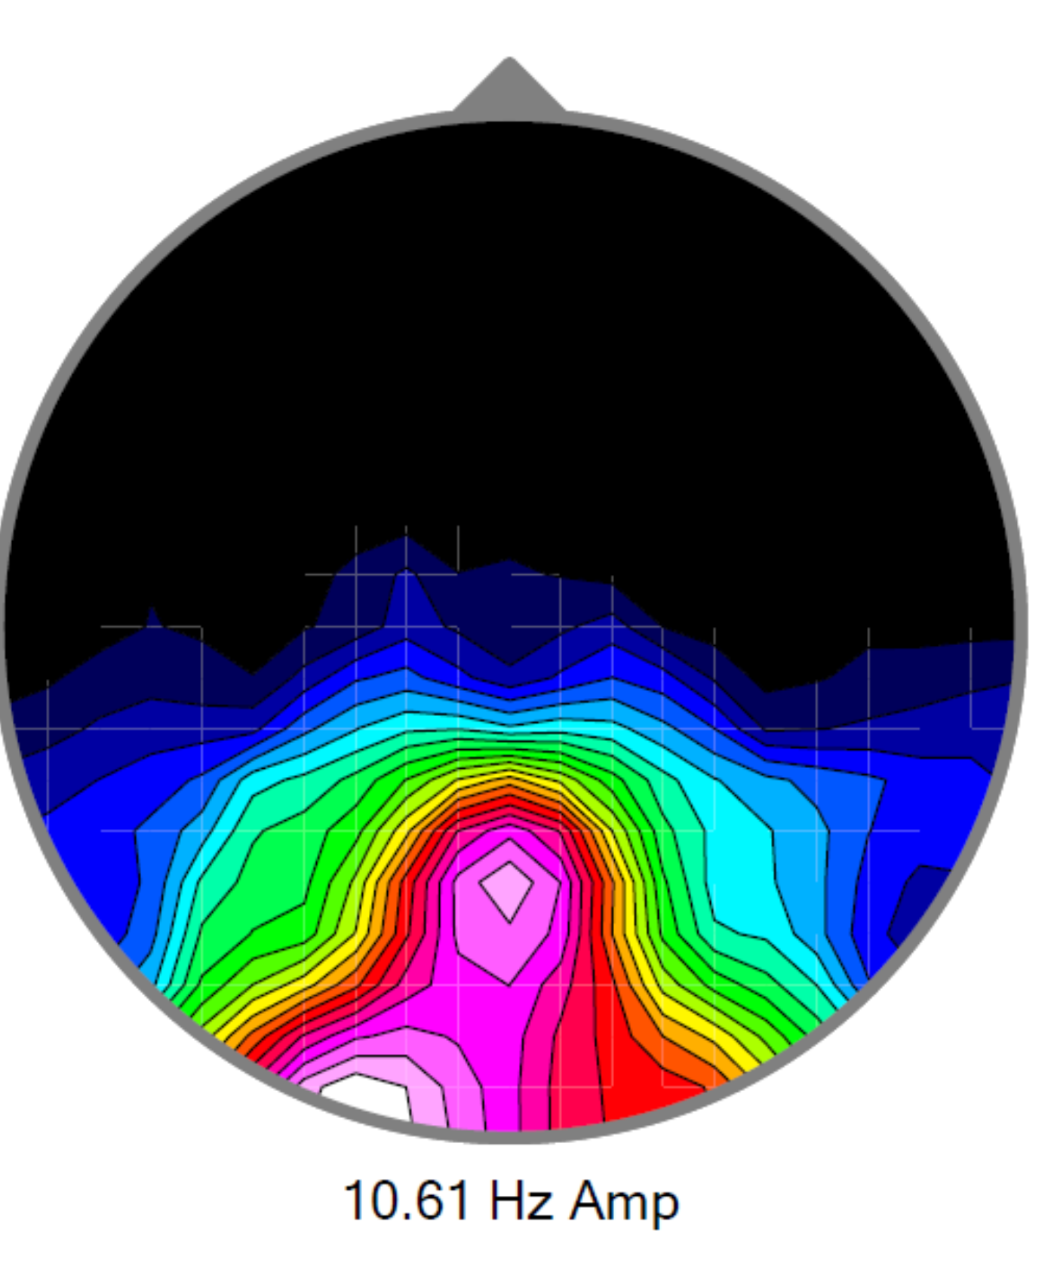
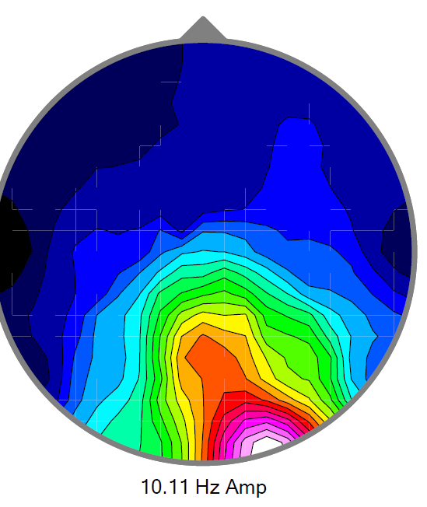
PTSD: 6 Weeks of ITMS Treatment
Lt. Coln. Marines (Retired)
20 years service
Iraq, Africa, Afghanistan
Pre-EEG
Pre-Treatment:
Short temper
Short focus and concentration times
Extreme muscular tension
Intrusive, violent thoughts
Estrangement from family and colleagues
Alcohol self-medication
No dreams, occasional nightmares
~4 hours sleep
Post-Treatment:
No more intrusive, violent thoughts
Normal body tension; relaxed
Increased social relations; no isolation
Social drinking (1 to 2 drinks); no self-medication
No temper; ability to handle stressors without anger
Restoration of focus and concentration
8 hrs of sleep per night
Dream restoration without nightmares
Extreme body tension and perseveration of dangerous scenario thoughts.
Post-EEG
Normal Brain
Has embraced a new and profitable career leveraging what he has learned and is newly engaged to be married.

Slide 36
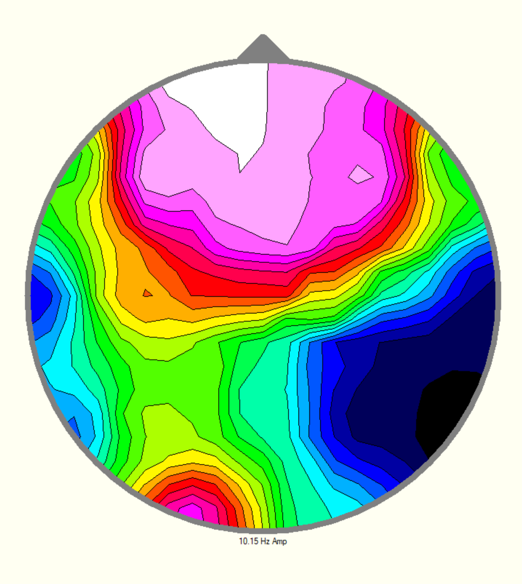
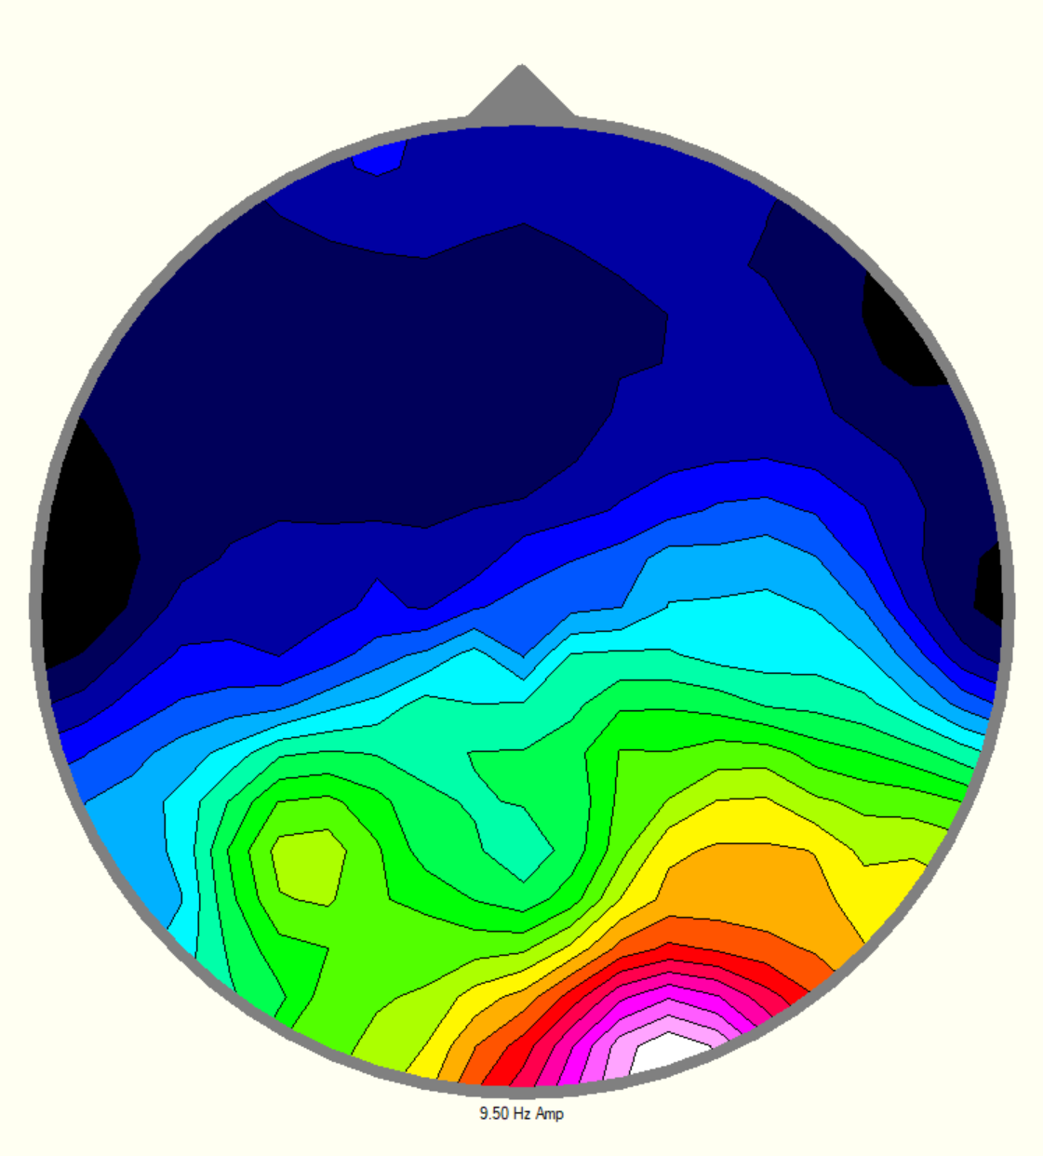
PTSD: 4 Weeks of ITMS Treatment
Navy Seal, Active Duty, 10+ years as Special Operator. Awarded the Navy Commendation Medal, Army Commendation Medal, Navy and Marine Corp Achievement Medal, Meritorious Volunteer Service Medal
Pre-EEG
Pre-Treatment:
Reclusive
Avoidance of all public spaces
Unmanageable Temper
Unbearable social anxiety
Nightmares
~5-6 hours of poor sleep
Abandonment of hobbies
Marriage and family life in trouble
Increased alcohol consumption
Post-Treatment:
Meaningful, restful and restorative sleep
Restoration of proper family life relations
Return to public spaces without dread
Crowning achievement: Took children to the Mall!
No temper; ability to handle stressors without anger
No social anxiety
8 hrs of sleep per night
Dream restoration without nightmares
Social drinking
Restoration of hobbies (drawing, sculpting, and car rebuilds)
2 years of sustained psychotherapy and prescribed drugs did not improve severe PTSD symptoms
Post-EEG
Normal Brain
Quote: “The way I see it, this treatment has saved my life, my marriage, and my relationship with my children”

Slide 37
So, Where To Next?
True Dose-Response Studies
Looking very much that “less is more”
Off-axis stimulation
Just because you have a frequency for central synchrony doesn’t mean you use that number
It is exquisitely clear that on-axis is
most useful in anxiety
Least useful in autism
Sugar
Yes, sugar

Slide 38
So, Where to Next?
D-ribose
Energy (ie. ATP) dynamics
Dilantin
Fully computer-controlled, real-time, Many A Day treatments (“MAD”)
Instantly adaptive to the brain
This is giving many fits at academic institutions
They can’t keep up because it is massively across disciplines
Remote monitoring by the Cloud and by Physicians
Combination Therapy
Laser based on NASA research
RF Modulation
Hyperbarics
Ultrasonics
Heavy metal excretion?
Neuronal and glial development?

